Slide 1

MICROPROCESSORS AND MICROCONTROLLERS (BECE204L)
DR. NAUSHAD MANZOOR LASKAR
ASSISTANT PROFESSOR SG-1
SCHOOL OF ELECTRONICS ENGINEERING (SENSE)
VELLORE INSTITUTE OF TECHNOLOGY, VELLORE

Slide 2
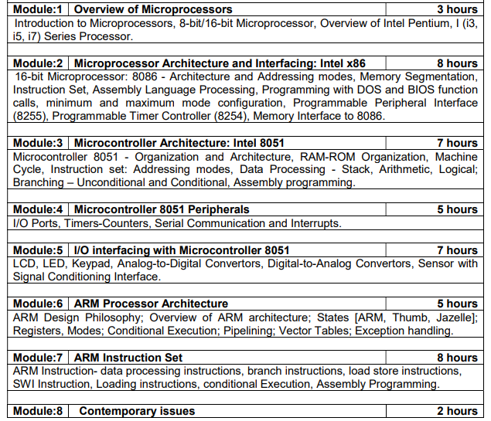
COURSE CONTENTS & LECTURE PLANNING

Slide 3
MODULE 4: 8051 Peripherals

Slide 4
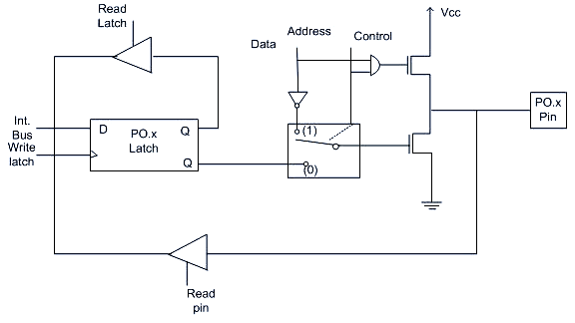
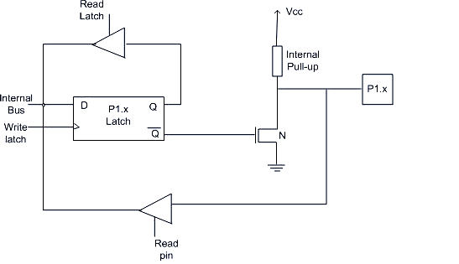
I/O Ports of 8051
4 I/O ports each of 8-bit, which can be configured as input or output. Hence, total 32 I/O pins allows the microcontroller to be connected with the peripheral devices.
PORT 0: Can be used as a bidirectional I/O port or it can be used for address/data connected for accessing external memory. When control is 1 the port is used for address or data interfacing. When the control is 0 then the port can be used as a bidirectional I/O port.
Output Port: If we want to write 1 on pin of P0, a '1' written to the latch which turns 'off' the lower FET while due to '0' control signal upper FET also turns off.
Suppose we want to write '0' on pin of port 0, when '0' is written to the latch, the pin is pulled down by the lower FET. Hence the output becomes zero
Input Port: If the control is 0 then the port is used as an input port and 1 is written to the latch. In this type of situation both the output MOSFETs are off. Since the output pin has floats therefore, whatever data written on pin is directly read by read pin
PORT 1:PORT 1 is dedicated only for I/O interfacing. When used as an output port, not needed to connect additional pull-up resistor like port 0. To use PORT 1 as an input port '1' has to be written to the latch. In this mode 1 is written to the pin by the external device then it read fine

Slide 5
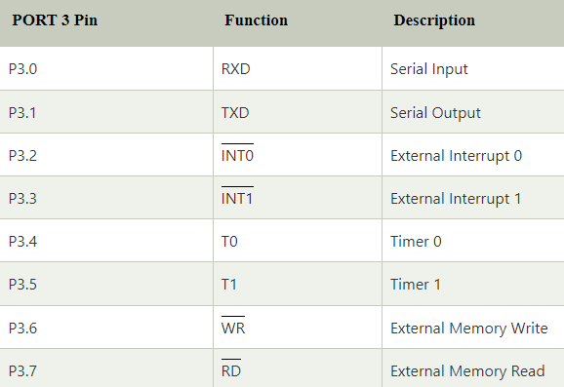
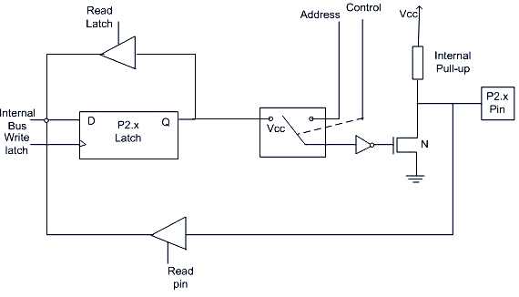
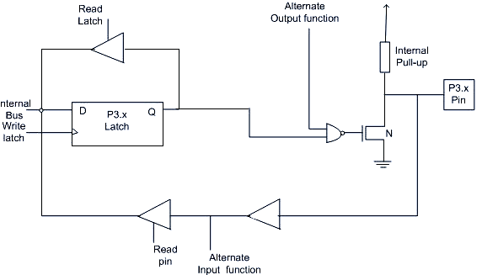
I/O Ports of 8051 (contd…)
PORT 3: Following are the alternate functions of PORT 3:
PORT 2: It is used for higher external address byte or a normal I/O port. Here, the I/O operation is similar to PORT 1. Latch of PORT 2 remains stable when Port 2 pin are used for external memory access
It works as an I/O port same like port 2. Alternate functions of port 3 makes its architecture different than other ports

Slide 6
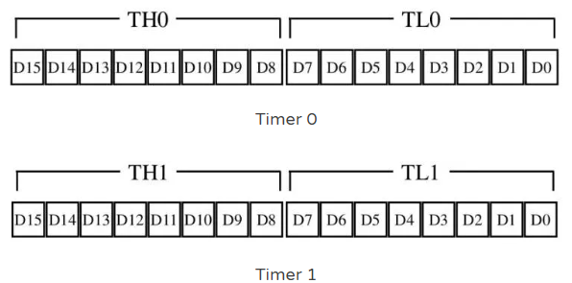
Timers and Counters of 8051
Microcontrollers have an independent timer in tandem with a clock on board.
These timers help microcontrollers generate precise time delays and keep operations in sync with themaster clock, which is the heart of the microcontroller.
Not only this, but these timers also help optimize CPU utilization as they can generate delays independently
Timer 0 and Timer 1 Registers
The 8051 microcontroller has two timers, namely Timer 0 and Timer 1.
Both these timers are 16-bit registers. Since the 8051 microcontroller has an 8-bit architecture, these registers are divided into two parts TL (Lower 8-bits) and TH (Upper 8-bits) . These timers, play the dual functions of being timers and counters
WORKING
A pre-scaler scales the clock pulses from the master clock that are sent into the timer.
In the case of the 8051 microcontrollers, the master clock frequency is divided by 12 and then fed into the timer.
This helps to increase the accuracy of time kept but decreases the range at the same time.
The reason for having the pre-scaler value set to twelve is because each machine cycle for the 8051 microcontroller takes 12 clocks, and this helps keep everything in complete synchronization
Once the pulses reach the timer, it starts counting up from 0000 to FFFFH
As mentioned the timers on the 8051 microcontroller are 16 bit in size.
This means that they can count up to a maximum value of FFFFH.
The input signal to these registers is a prescaled version of the master clock making them count upwards at particular durations of time. Each of these pulses from the pre-scaler increases the value in the register until it reaches its upper limit of FFFFH.
Once the register reaches FFFFH and is said to have overflowed the microcontroller resets the timer register to 0000H and sets the TF1/TF0 bit in TCON register to 1.
This is to alert the programmer that the overflow has taken place. Now this change in the value of TF1/TF0 flag will occur at regular intervals of time and can be used to generate accurate time delays.

Slide 7
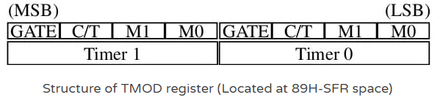
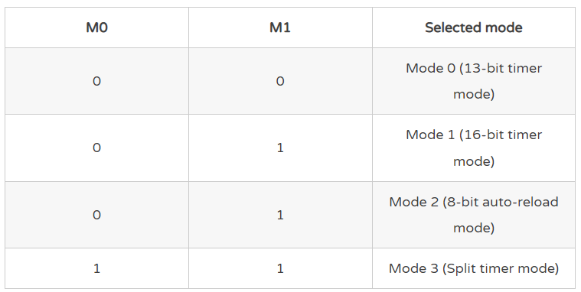
Purpose of the TMOD and TCON registers in 8051
TMOD (Timer mode register) –
The timer registers can operate in four different modes. The selection of the functioning mode is done in this register. Additionally, the overall function of the timer registers, whether to work as timers or counters, is done here too.
It is an 8-bit special function register that is placed at the address 89H in the ROM space and is not bit addressable
It is divided into two 4-bit registers to manage T0 and T1, respectively. The lower 4 bits manage the modes for Timer 0, and the higher four bits manage Timer 1. These four bits are Gate, C/T, M1, and M0
Gate:
If the timers are put to use by using external hardware (like interrupts): TR0/TR1 bit (in TCON register) = HIGH; GATE bit = HIGH; and / pins of the microcontroller = LOW.
If the timers to use using software: TR0/TR1 bit (in TCON register) = HIGH; GATE bit = LOW; and pins of the microcontroller = LOW
M0 and M1
C/T: These timer registers can be used as both timers and counters to keep time and to count external events. To use it as a timer the C/T bit is set to 0(counts internal pulses) whereas it is set to 1(counts external pulses) if it needs to be used as a counter of events

Slide 8
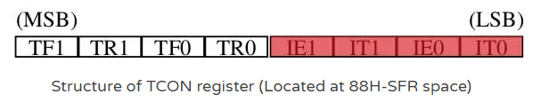
TCON (Timer Control Register) –
Only half of the TCON register is used for timing and counting purposes. This register is used to initialize the counting and to indicate when the timers have reached their counting limit.
It is used to send the control signals for the functioning of the timer.
The TCON register is bit addressable and is places at the address 88H in the ROM.
It is an 8-bit register that starts the timer and also contains the flag which gets updated when the timer overflows
TF1 and TF0 are timer flags that indicate overflow condition in timers 1 and timer 0 respectively.
When an overflow condition is reached, the value is changed to 1 from 0. TR0 and TR1 are used to start timers 0 and 1.
When a value 1 loads into these registers, the timers start counting from the values which are inside them

Slide 9
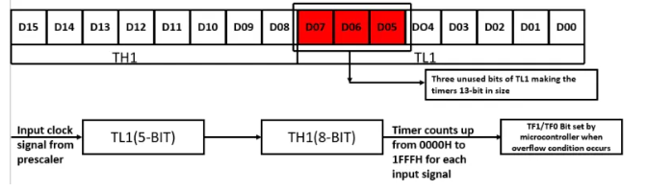

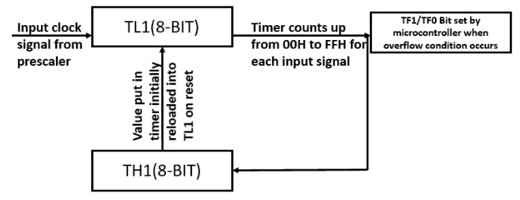
Timer modes in 8051 microcontroller
Mode 0: In this mode, both the timers act as 13-bit counters. What this means is that they can count up from 0000 to 1FFFH. The primary use of this mode is to provide backward compatibility with older microcontrollers like 8048. This mode offers a smaller counter size and is similar to mode one
Mode 1: In this mode, both the timers act as 16-bit timers, enabling them to count from 0000 to FFFFH. Most programmers use this mode due to its high counting capacity. One issue of this mode is that the start value has to be put in the timer registers after each cycle increasing software overhead
Mode 2: This mode comes with an auto-reload function, which helps deal with the software overhead issue in mode 2. In this configuration, the timer acts like an 8 bit counter and uses the lower bit (TL0/TL1) as the actual counter. As it is an 8 bit counter, it counts from 00 to FFH. The higher bit (TH1/TH0) acts as a storage element that stores and inputs the value to the lower bits when they rese

Slide 10
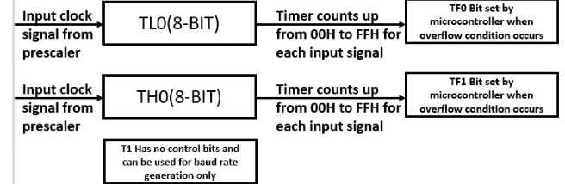
Timer modes in 8051 microcontroller
Mode 3: In this mode, both T0 and T1 behave differently. T0 works as a two 8 bit counters. The lower 8 bits use the control signals for T0 in both TMOD and TCON registers, whereas the second 8-bit counter in T0 uses the control signals for T1. Due to this reason, T1 has no control bits and can be used only for baud rate generation. This mode is beneficial when two timers and baud rate generation are required simultaneously.
Counters in 8051 microcontroller
Timer registers in 8051 are upward counters, increasing the value stored in them on each input clock signal.
In the case of timers, this clock frequency is given by the pre-scaler (making it count upwards every 1.08 millisecond).
Whereas in the case of a counter, this signal is given by any input value. Now that the clock signal to the register is given by an external stimulus, it counts upwards for each clock pulse given by the external peripheral making it act as a counter.
All of the things mentioned above about timers are applicable for counters; the only difference being in the value of C/T bit in TMOD register.
Note: Due to the 16-bit size of timer registers the maximum value you can count up to is 65536 after which the timer is reset. Input signals are taken from port 3.4 for timer 0 and port 3.5 for timer 1.

Slide 11
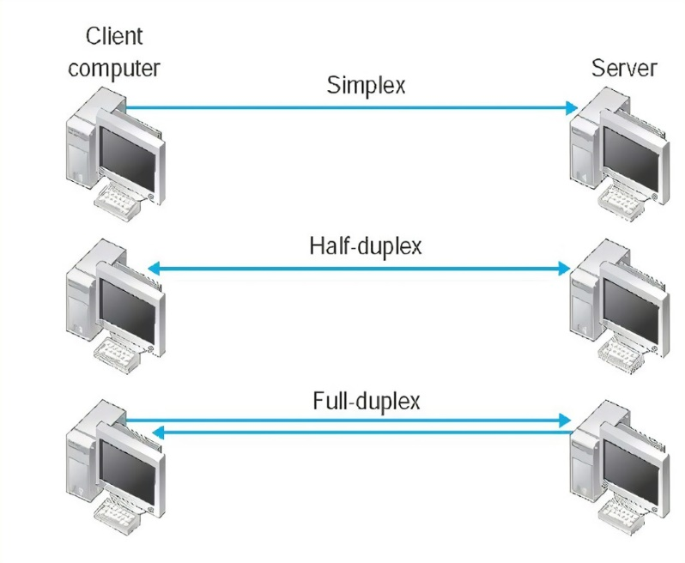
Serial Communication in 8051
Computers can communicate with one another using serial or parallel transmission of data.
In the case of serial communication, one wire is enough to send multiple bits of data in the form of a stream of bits. But for parallel communication individual wires are required for each bit.
Serial Communication
Modes
Synchronous
Asynchronous
Two devices communicating with another use the same clock signal to synchronize the data transmission.
What that means is that we use a clock. The clock is common to both the communicating parties.
The reason we use the clock is to tell the devices when the data is being sent and at what speed it needs to sample the data to make sense of it.
This makes it faster and more efficient as it does not have any overhead in terms of start and stop bits.
Does not use a synchronizing clock signal when transferring data.
It uses special characters known as start and stop bits which help the computers synchronize their communication.
These bits also help the communicating devices know when a frame of data is over.
This makes it cheap to implement but can be less efficient when compared to synchronous communication.

Slide 12
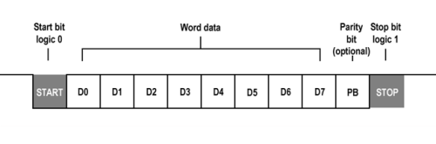
UART in Serial Communication
8051 uses a special circuit that, by design, for communication. This special circuitry or module is known as a UART. Its full form is Universal Asynchronous Receiver or Transmitter
Asynchronous mode of data transmission.
In the case of asynchronous data transmission, individual bits of data are transferred in the form of frames.
These frames have gaps in between them so that the device can synchronize itself to receive data as it does not use an external clock
Framing
A UART frame consists of the data to be transmitted (8 bits/9 bits) and Start and Stop bits.
In some cases, the number of stop bits can be two, but the start bit is always a single bit.
Also, the 8051 supports full-duplex communication which means it can transmit and receive data at the same time. This is made possible by the special design of the SBUF register
The start bit helps in synchronization and is a low signal for a particular duration of time. The stop bit is a high bit and is followed by a space of low signal, which is used to tell the receiver that a particular character has been transmitted.
In some cases, a parity bit is also sent with the data to check for transmission errors.
Some modern microcontrollers with 8051 IP cores support multiple UARTs in addition to other protocols like the I2C and SPI for easy interfacing with other devices

Slide 13
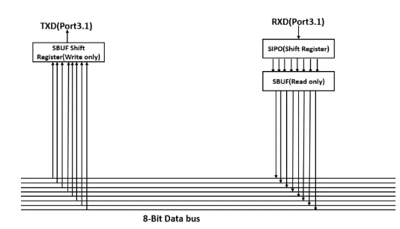
Registers used in Serial Communication
SBUF register – These are two buffer registers that hold the received data and the data to be transmitted
8-bit register which is used only for serial communication.
The SBUF register is actually two registers and not one. Before transmitting or receiving any data placing it in the SBUF register is essential.
During transmission start and stop bits are added to the data once it is placed in the SBUF register, and then the data is transferred through the TXD pin(Port 3.0).
In the case of reception, the data is received through the RXD pin (Port 3.1), placed in the SBUF register, and framing bits are removed
The SBUF register is placed at memory location 99H of the 8051 SFR memory space.
It consists of two registers and shift registers to convert the serial data into parallel or visa versa.
As the 8051 has two independent registers, it can transmit and receive data at the same time.
The shift register in the RXD side acts as a buffer. It allows one byte of data to be received while another is stored in the buffer. If one byte is read by the CPU and the other is not fulls received this mechanism prevents erroneous reception.

Slide 14

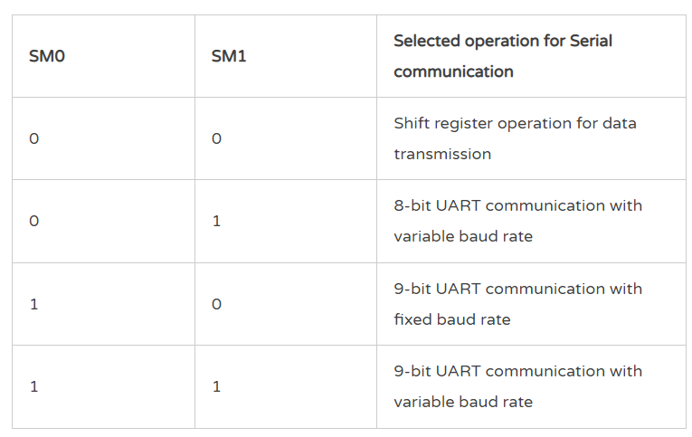
Registers used in Serial Communication
SCON register – The control center for serial communication in 8051
To manage asynchronous communication between devices, the SCON register is used. The SCON register is placed at the address 98H and is bit addressable
SCON register is the main control register for UART
SM2: This bit is used to enable multiprocessor communication in modes 2 and 3. This pin is mostly set to 0
REN: The Ren bit enables or disables reception. If Ren bit is high, then the microcontroller can receive data at port3.1, but when it is 0, this port is disabled.
TB8: This register stores the 8th bit in mode 2 and 3 during transmission
RB8: This register stores the 8th bit in mode 2 and 3 during the reception of data
TI: This interrupt is raised by the hardware when the transmission is complete for a block of data.
RI: This interrupt is raised by the hardware when a complete block of data is received.
SMO and SM1- These bits select the mode of serial communication

Slide 15
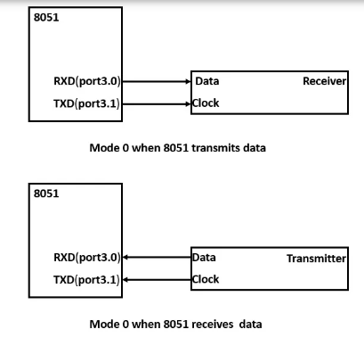
Registers used in Serial Communication
TMOD register – The register that controls the speed of transmission. There are a total of four modes. Out of these, three modes enable asynchronous communication (modes 1,2, and 3). Mode 0 enables synchronous shift-register mode.
Mode 0
During this mode, the transfer of data occurs in a synchronous fashion.
The TXD (which originally stands for transmission) pin (Port 3.1) is used to send/receive the synchronizing clock signal.
And the RXD (which stands for Receive) pin (Port 3.1) is used for transferring and receiving the data. Reception of data requires REN=1 and RI=0.
In this mode, the synchronizing clock signal is the frequency of one machine cycle. In the case of 8051, this is (11.059Mhz/12=921.6Mhz).
Just to emphasize, the TXD pin’s function can be a little misleading as it is used here for sending the synchronizing clock signal.
In this mode, data is transferred as it would in a shift register—bit by bit with a common synchronizing clock signal.
8-bit data is shifted, LSB first.
Transmission starts as soon as data is written into SBUF.
Value of SCON for transmitting data in mode 0 = 00H.
Value of SCON for receiving data in mode 0 = 10H.

Slide 16
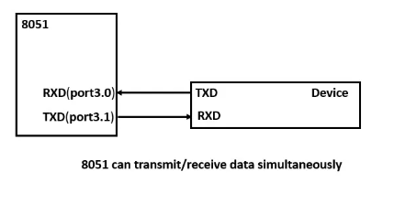
Registers used in Serial Communication
Mode 1
It is the most commonly used mode for UART based serial communication.
Used mostly for a majority of your simpler UART related applications.
In this mode, the UART circuitry is used, and the data can be transferred at variable baud rates which are generated by Timer 1.
Here the 8051 follows a full-duplex mode of communication and can transmit and receive data at the same time.
For mode 1 in full-duplex, the value 50H should be inserted into SCON register
For mode 1 in half-duplex, the value 40H should be inserted into SCON register
number of bits transmitted per second
Mode 2
This mode also implements UART communication but can be used to transfer/receive 9 bits of data.
The baud rate during this mode is fixed to the machine cycle frequency. We’ll look into baud rate generation in the subsequent sections.
TB8/RB8 store the 9th bit during the same.
The ninth bit is used for sending party bits or is used in multiprocessor communication.
the ninth bit is managed by TB8/RB8 in the SCON register.
For mode 2 in full-duplex, the value 90H should be inserted into the SCON register.
For mode 2 in half-duplex, the value 80H should be inserted into the SCON register.
Mode 3
This mode is similar to mode 2 but can transfer data at variable baud rates generated by timer 1.
For mode 2 in full-duplex, the value 130H should be inserted into the SCON register.
For mode 2 in half-duplex, the value 120H should be inserted into the SCON register

Slide 17
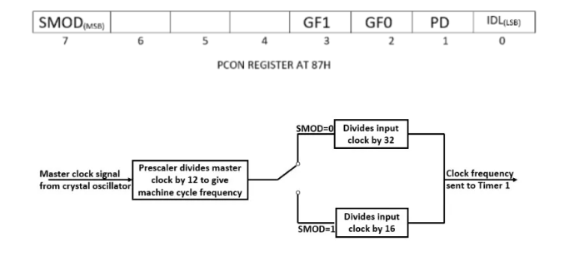
Registers used in Serial Communication
PCON register – Used to double the speed of transmission
Bit 7 of the PCON register can be used to double the baud rate. When the SMOD bit is set to 0 the value of the dividing factor changes from 32 to 16 due to which the baud rate doubles
The following formula can be used to find the value to be put in TH1 when SMOD=1
TH1=256 – (Crystal Frequency)/(192 x Baud rate)
when SMOD=0
TH1=256 – (Crystal Frequency)/(384 x Baud rate)

Slide 18
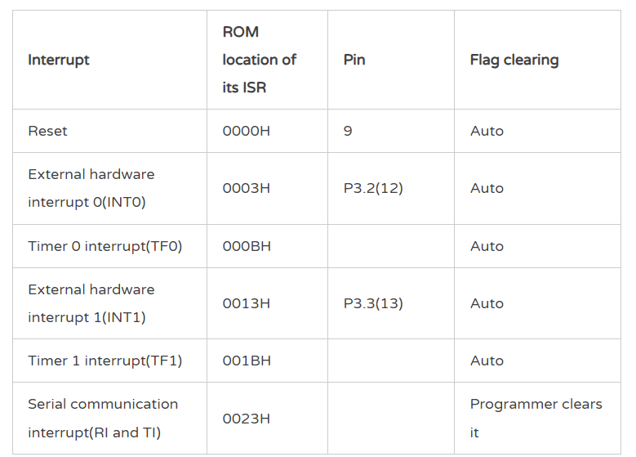
8051 Interrupts
An interrupt is a signal sent by hardware or software processes calling for the immediate attention of the CPU. Once the CPU receives this signal it stops whatever it is doing and takes care of that particular resource.
8051 has a total of six interrupts and each interrupt has a designated interrupt service routine (ISR)/interrupt handler assigned to it.
The ISR is a predefined code that is stored at a particular memory location in the ROM that the microcontroller executes when the designated interrupt arises.
A table known as the “interrupts vector table” is responsible for storing the address of the ISR
Highest Priority
Except the Reset interrupt’s ISR, all other ISRs occupy 8 bytes of space. The Reset interrupt’s ISR, however, occupies only 3 bytes
Note: Whenever interrupts are enabled an LJMP instruction is used to bypass the memory space which contains the ISRs. The microcontroller starts executing its operation from 0000H and if it were to execute in a sequential manner it would encounter the ISR memory space between 0000H and 0023H. So to bypass the same LJMP the programmer can use a jump instruction

Slide 19
What happens inside the microcontroller when an interrupt occurs?
The CPU of the microcontroller is busy performing a task (like you binge-watching a show) when it receives an interrupt from a certain resource (Call on your phone).
At this moment the CPU stops whatever it is doing and takes care of the resource which causes the interrupt. (You decided that you’d like to pause the show and take the call.)
Hang on though. You’ve paused your show. Once the call ends, you will continue watching from where you left off. Similarly, the microcontroller will take a moment, finish the current execution, store the address of the next instruction that it has to come back to on the stack and then service the interrupt by branching to the address of the ISR.
How does it branch to the ISR? Simple, it stores the addresses of all the interrupt service routines in the memory in an interrupt vector table.
It retrieves the address, stores it in the program counter, and branches to the ISR.
Meanwhile, when the interrupt is being executed, all the remaining lower and equal priority interrupts are latched and waiting for the current ISR to end.
The ISR executes until it reaches the RETI instruction.
Once it encounters the RETI keyword, the latched interrupts (if available) are now active and execute their respective ISRs. Else, the address of the next instruction that would have been executed had an interrupt not arisen is fetched from the stack into the PC and normal execution resumes

Slide 20
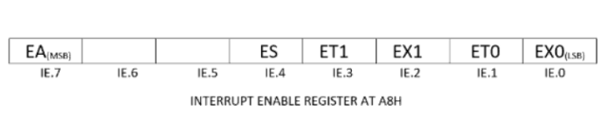
Interrupt Enable Register
By default, all the interrupts on the 8051 microcontroller are disabled. Hence, we need to use the Interrupt Enable register to enable them
EA: Enables the interrupts in 8051. By default, it is set to zero. You need to place a 1 here to enable all interrupts. This bit is the Master Control.
ES: Serial communication interrupt. Write 1 to enable, 0 to disable.
ET1: Interrupt for timer 1. Write 1 to enable, 0 to disable.
EX1: External interrupt 1 (p3.3). Write 1 to enable, 0 to disable.
ET0: Interrupt for timer 0. Write 1 to enable, 0 to disable.
EX0: External interrupt 0 (p3.2). Write 1 to enable, 0 to disable.
The rest of the bits can’t be used by the programmer

Slide 21
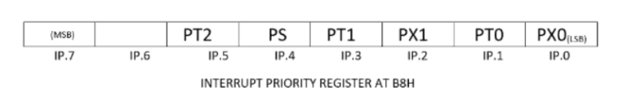
Interrupt Priorities in 8051
The interrupts in the 8051 microcontrollers have certain priorities assigned to them. This helps the microcontroller decide which interrupt to service first if two of them occur at the same time
The Reset interrupt has the highest priority.
If any of the bits in the IP register has a value one its priority of that interrupt is increased
PT2: Increases the priority of timer 2 (for 8052 only)
PS: Increases the priority of the serial interrupt
PT1: Increases the priority of timer 1
PX1: Increases the priority of external interrupt 1
PT0: Increases the priority of timer 0
PX1: Increases the priority of external interrupt 0

Slide 22
External Interrupts
Two ports on the 8051 microcontroller; pins 12 (INT0) and 13 (INT1) in port 3 can be used as external interrupts.
Once the microcontroller gets a signal from an external device on these ports, it interrupts its operation and starts executing the ISR meant for the external interrupt
Level trigged
By default, the external interrupts are level triggered.
When the pins 12/13 receive a low-level signal for a minimum duration of four machine cycles an interrupt occurs.
This low-level signal must be transferred to a high level before the microcontroller reaches the RETI instruction in the ISR.
If the signal remains low after the RETI instruction, it will interrupt the microcontroller again. Due to this, the microcontroller can get stuck in a loop of interrupts.
Edge triggered
To configure ports 12/13 as edge-triggered interrupts the TCON register is used.
The TCON register is bit addressable.
Setting IT0/IT1 bits of the TCON register configures these ports as edge-triggered interrupts.
A falling edge on the ports during this mode interrupts the microcontroller.
This signal should be kept high for 1 machine cycle and then low for another 1 machine cycle. This enables the microcontroller to identify the signal easily.
IE0 and IE1 in the TCON register are used to tackle the problem of looping inside interrupts, which occurs during external edge-triggered interrupts. The CPU sets IE1(P3.3)/IE0(P3.2) as 1 when it encounters an edge-triggered signal at any of the two ports. When either of this bit is 1, the CPU ignores any other falling edge signal on the port, preventing reoccurring interrupts.

